Slide 1

Fatal Police Shootings in the United States from 2015-2022 Team 7 Midterm Exploratory Data Analysis Alex Khater, Rajeev Koneru, Cora Martin

Slide 2

Data Set Information
In response to a severe lack of reporting within government sources, The Washington Post compiled a database of every fatal police shooting in the United States from 2015-2022. We are interested in exploring this data, specifically as it relates to differences between U.S. states and regions.
After accounting for null values, the data set we are working with has 6,574 observations. Below we have provided a sample row of the data:
Name | Date | Manner of Death | Armed | Age | Gender
Tim Elliot | 10/04/2022 | Shot | Gun | 53 | M
Race | City | State | Signs of Mental Illness | Threat Level | Flee
A | Shelton | WA | 1 | TRUE | Not fleeing
Body Camera | Longitude | Latitude | Is Geocoding Exact
FALSE | -123 | 47.2 | TRUE

Slide 3
Univariate analysis

Slide 4
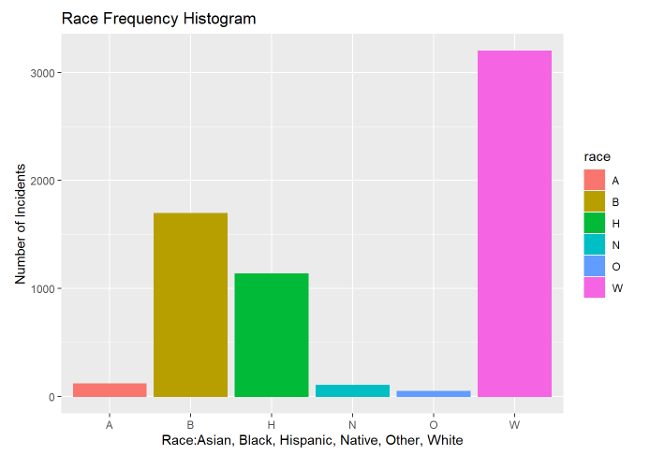
Race Frequency

Slide 5
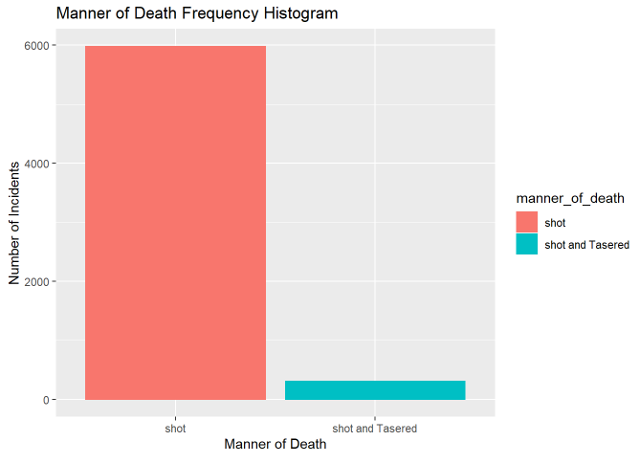
Manner of Death Frequency

Slide 6
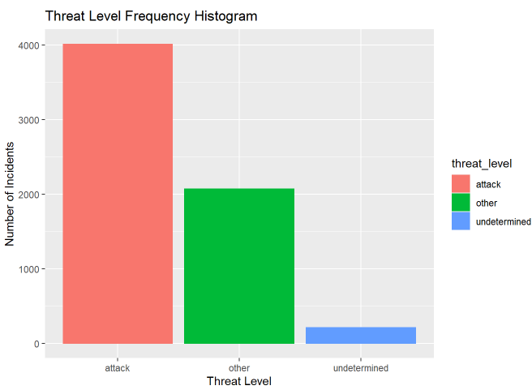
Threat Level Frequency

Slide 7
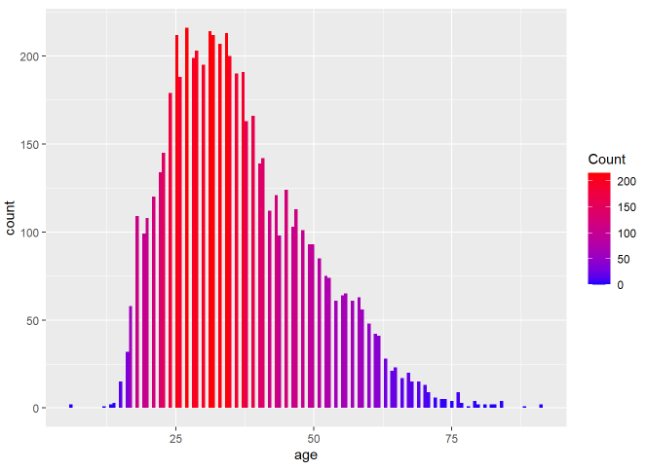
Age Distribution

Slide 8
Multivariate Analysis

Slide 9
Geospatial analysis

Slide 10

file:///C:/Users/ADMIN/Desktop/masters/GW/intro%20to%20data%20science/project_r/geospatial_analysis.html

Slide 11
Race/Age/Gender Analysis

Slide 12
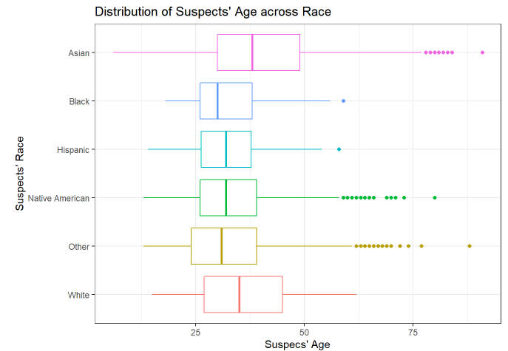
Distribution of Suspect’s Age across Race

Slide 13
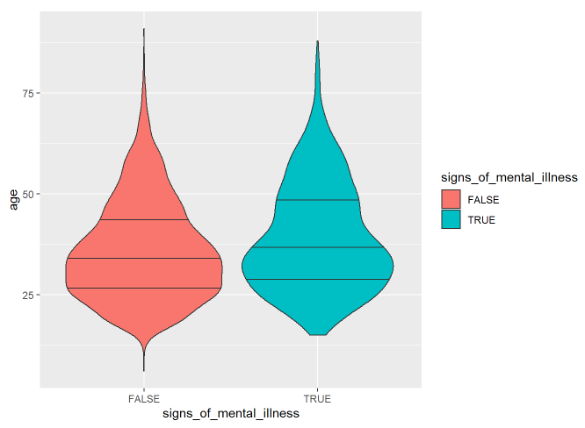
Signs of Mental Illness

Slide 14
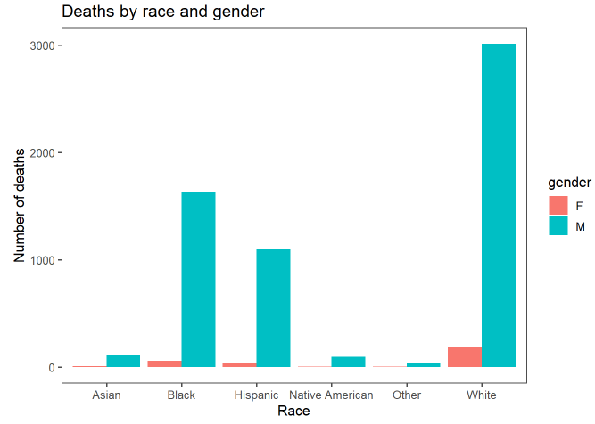
Deaths by Race and Gender

Slide 15
Suspect’s Condition

Slide 16
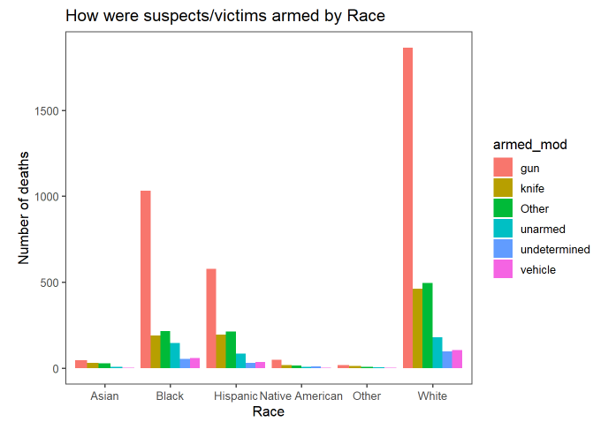
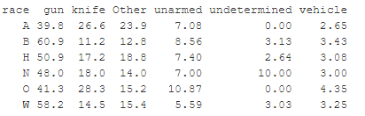
distribution of deaths by Armed Category in each Race

Slide 17
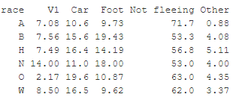
distribution of deaths by suspects' status (Fleeing or not fleeing) by Race

Slide 18
distribution of deaths by Armed Category in each Race

Slide 19
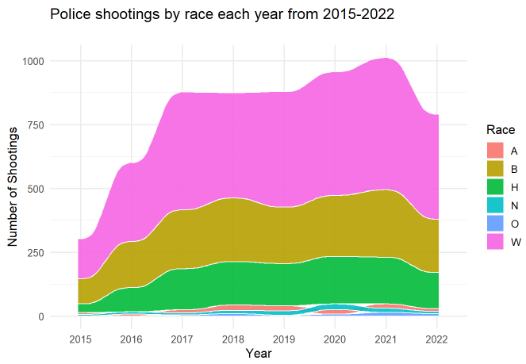
Police Shootings by Race each year from 2015-2022

Slide 20

Time Series Analysis

Slide 21
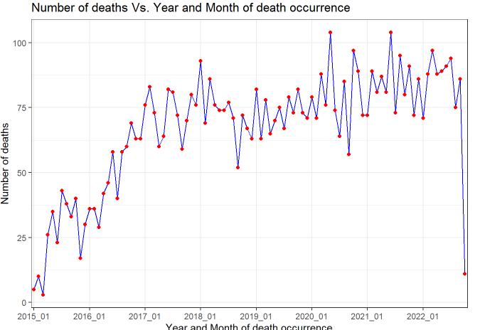
Number of deaths Vs. Year and Month of death occurrence

Slide 22
Seasonaility?

Slide 23
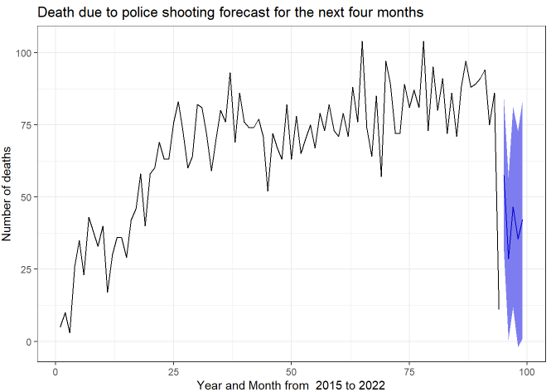

Slide 24
SMART Research Question
Within our data set of 6,574 observations of police shootings from 2015 to 2022 in the United States, is there a significant difference between the U.S. States’ proportions of fatal police shootings that are captured by body cameras?
S
Variables that matter for our question: US state where the shooting took place and whether the police body camera was on or off
M
Statistical analysis used to measure differences between many proportions (this will require data reshaping)
A
The amount of data is manageable with only 6,574 observations spanning over a seven-year period.
R
We may apply this research to state policy on body cameras during police work.
T
With three people working on this research, a couple of weeks are required to perform the data analysis.

Slide 25
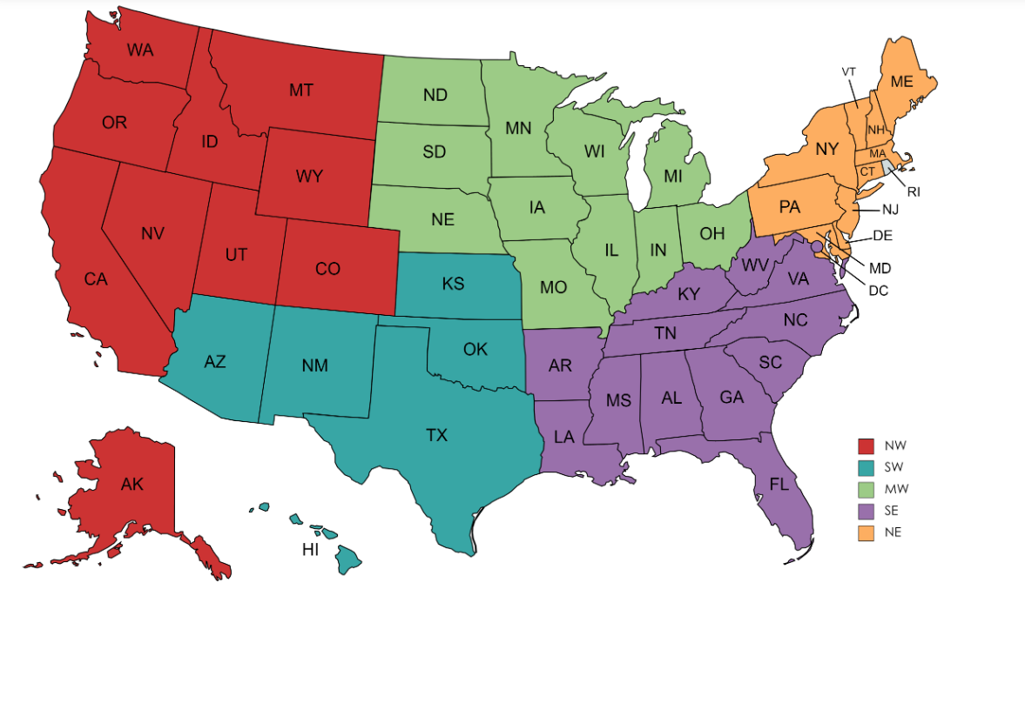
Reshaping Our Data for the SMART Q
Group Data and Variables by State to foster comparisons at the State level
Separated the Data into Regions for Graphical Display Purposes

Slide 26
A Key New Variable: stbcp
stbcp: the proportion of an officer’s body camera being on during a fatal shooting
Mean of stbcp= 0.144
This will allow us to compare states by proportion…

Slide 27
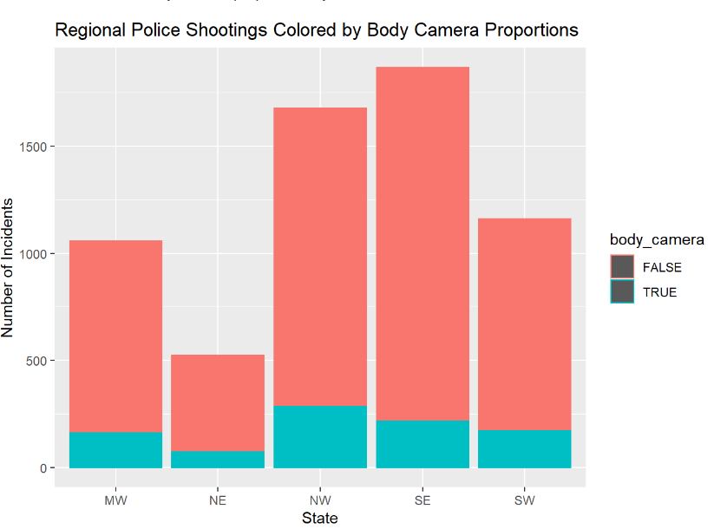
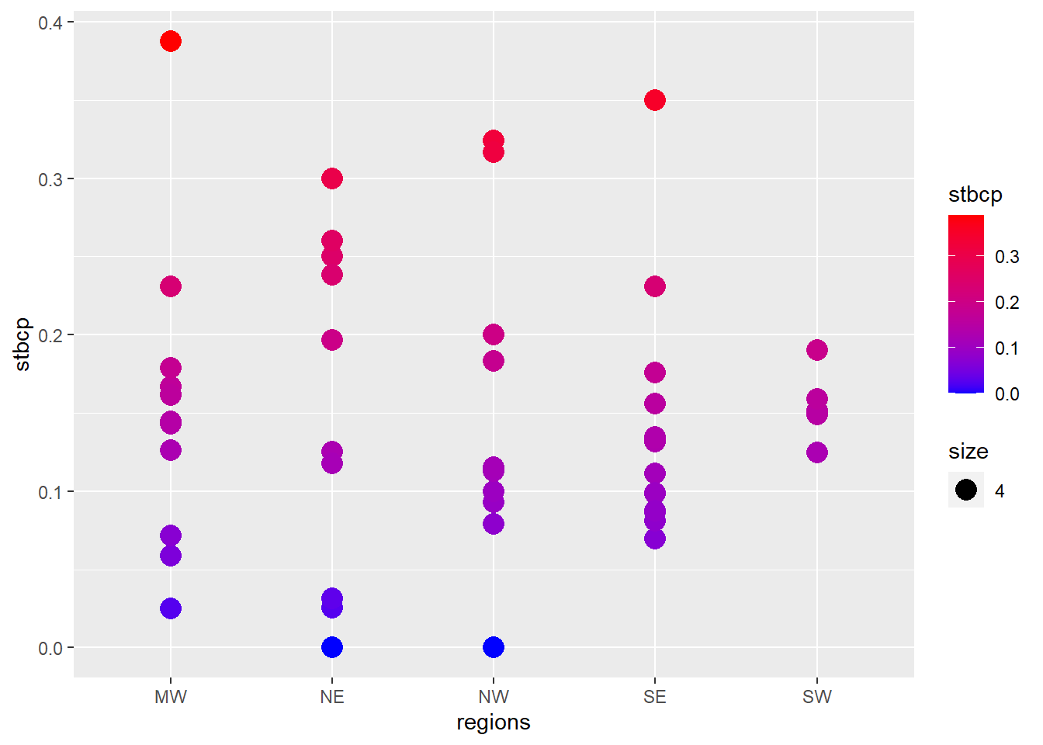
Body Cameras By Regions

Slide 28

How Do We Measure A Significant Difference ?
Introducing: The Chi-Square Test
The Chi-Square Test (X^2) is a test for comparing distributions of categorical variables
It works by comparing counts of each category and seeing if they differ from a preconceived “expected amount”
The Null Hypothesis is always: “The proportions are all equal” and The Alternative Hypothesis is always “The proportions are not all equal”
This test outputs a p-value (just like Z and T tests)

Slide 29
What are the conditions for using a Chi-Sq Test ?
Conditions:
Both Variables are Categorical:
a. We can check this off because “state” and “body camera” are
2. Independent Observations:
a. We know our observations to be independent as none of them meaningfully increase the probability of others (within the scope of this project)
3. Mutually Exclusive Categories:
a. Satisfied
4. Expected value of cells should be 5 or greater in at least 80% of cells.
a. Let’s talk about that…
Source: https://www.statology.org/chi-square-test-assumptions/

Slide 30
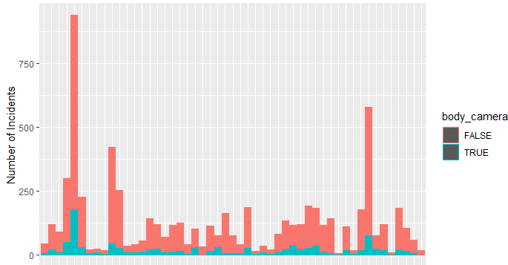
Conditions for using a Chi-Sq Test 2
We can see in our previous graphs that all our states have at least n=33 observations and the mean of stbcp is 0.144. So for the smallest number of state observations (AK)
0.144*33= 4.752
The rest of the states all have larger observation numbers (next smallest is 39), so we can say that 80% of our data easily passes this threshold of 5
Source: https://www.statology.org/chi-square-test-assumptions/

Slide 31
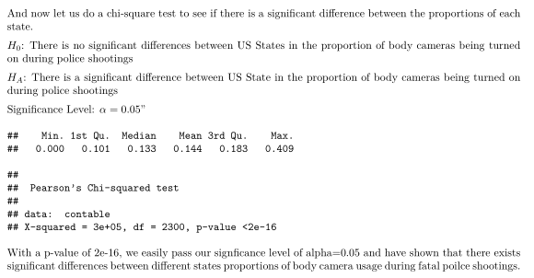
The Results
Source: https://www.statology.org/chi-square-test-assumptions/

Slide 32
Thank You For Listening
Questions ?

